Slide 1
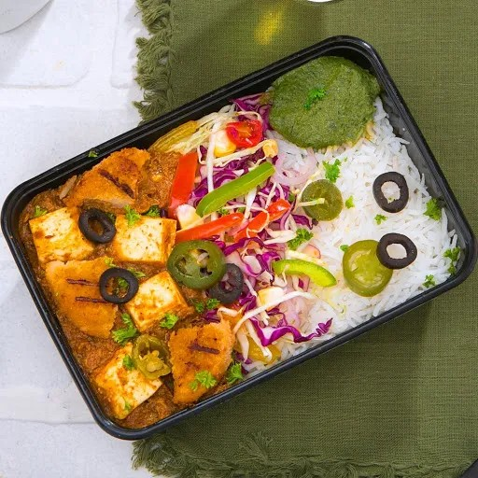
FoodBox Express
Presented By:-
Mayur Nandale
Karan Ekal
Vaishali Khetmalis
Swapnil Ghodekar

Slide 2
Project Overview:-
Welcome to FoodBox Express, the ultimate solution for all your food cravings! Our innovative concept brings together the convenience of online ordering with the deliciousness of freshly prepared meals. With just a few clicks, you can have restaurant-quality food delivered straight to your doorstep. At FoodBox Express, we believe that good food should be accessible to everyone. That's why we offer a wide range of cuisines to cater to different taste preferences. Whether you're in the mood for Italian, Chinese, or Indian, we've got you covered. And the best part? All our dishes are made using fresh and healthy ingredients, so you can indulge guilt-free!

Slide 3
TECHNOLOGY USED:-
Front End: | HTML , CSS , React.js , Nodejs
Back End: | MS. Net
Database: | MY SQL Server

Slide 4
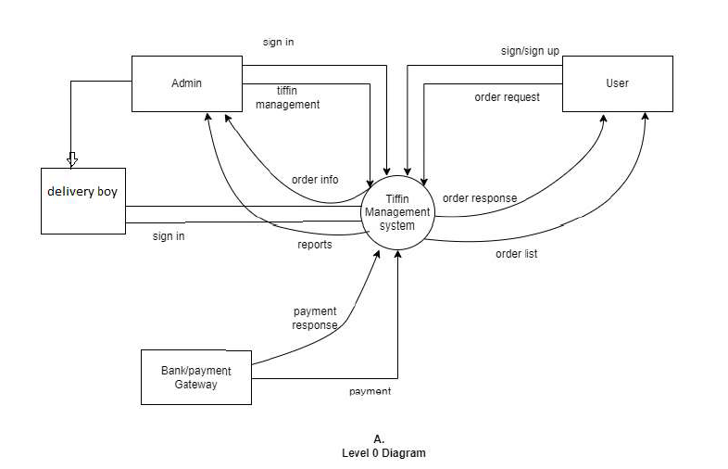
DFD DIAGRAM:-

Slide 5
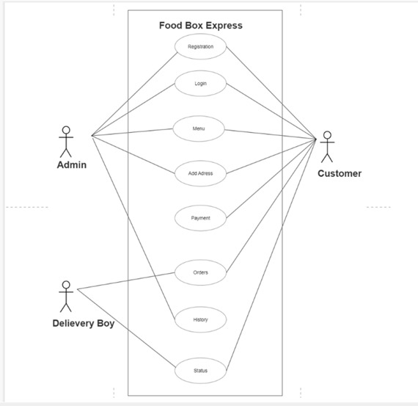
USE CASE DIAGRAM:-

Slide 6
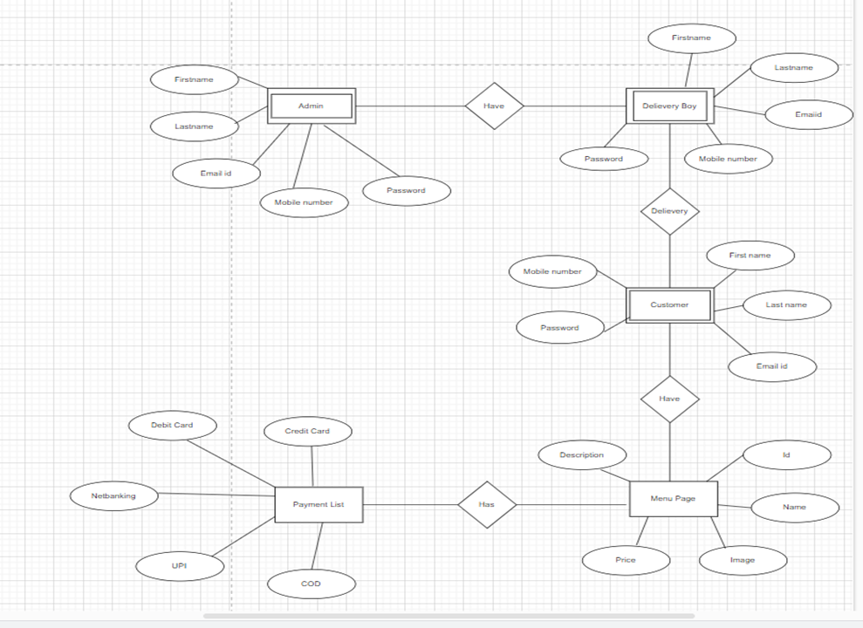
E-R DIAGRAM:-

Slide 7
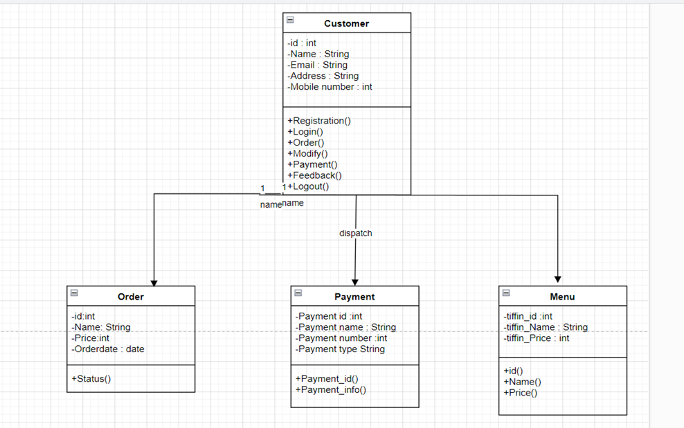
CLASS DIAGRAM:-

Slide 8
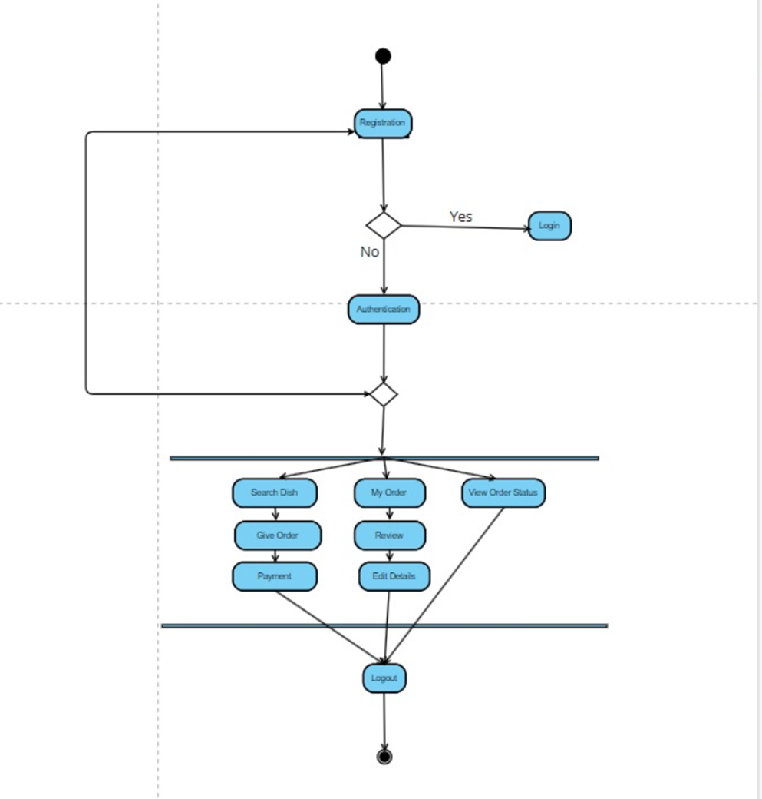
Activity Diagram:-

Slide 9
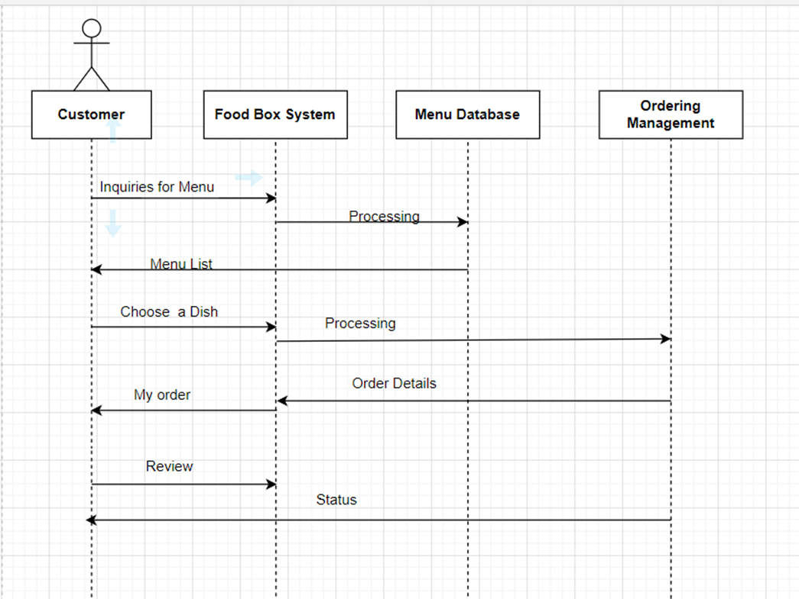
Sequence Diagram:-

Slide 10
MODULES USED:-
Admin
User
Delivery Boy

Slide 11
Admin:-
Admin Will Manage the :-
Customer List
Order History
Tiffin Management (Add/Delete/Edit)
Delivery Boy Management (add)
Add Delivery Address

Slide 12
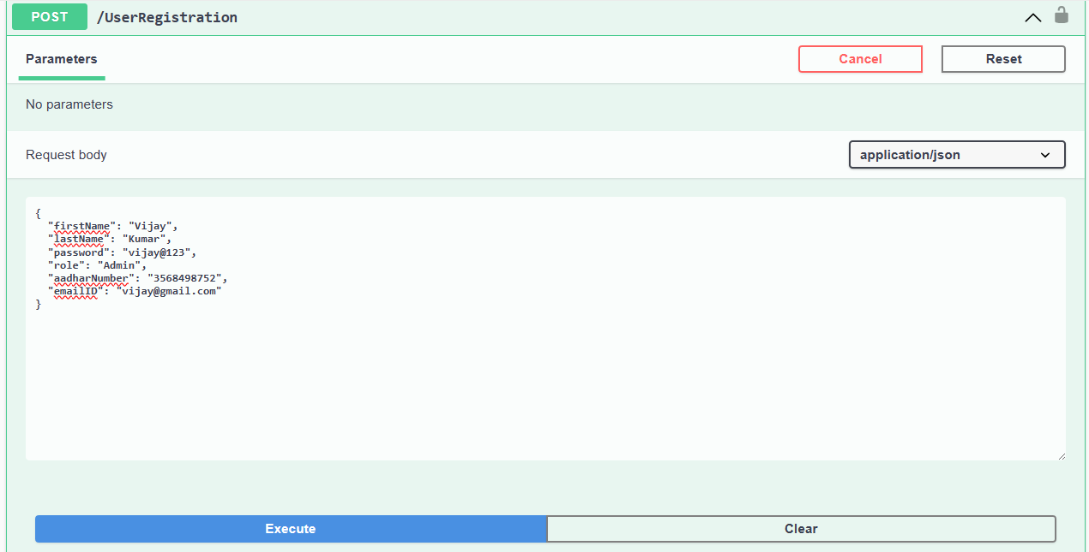
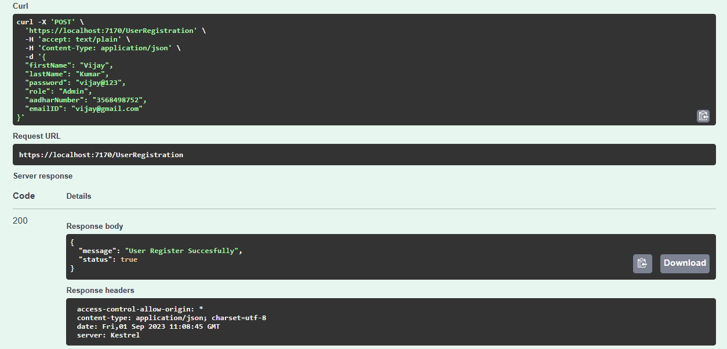
OUTPUT:- (Registration of New Admin)

Slide 13
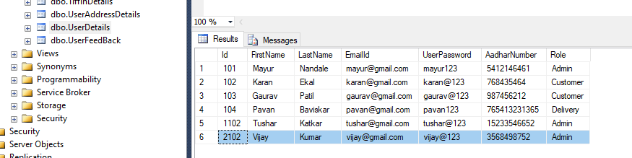
Admin Registered Successfully:-

Slide 14
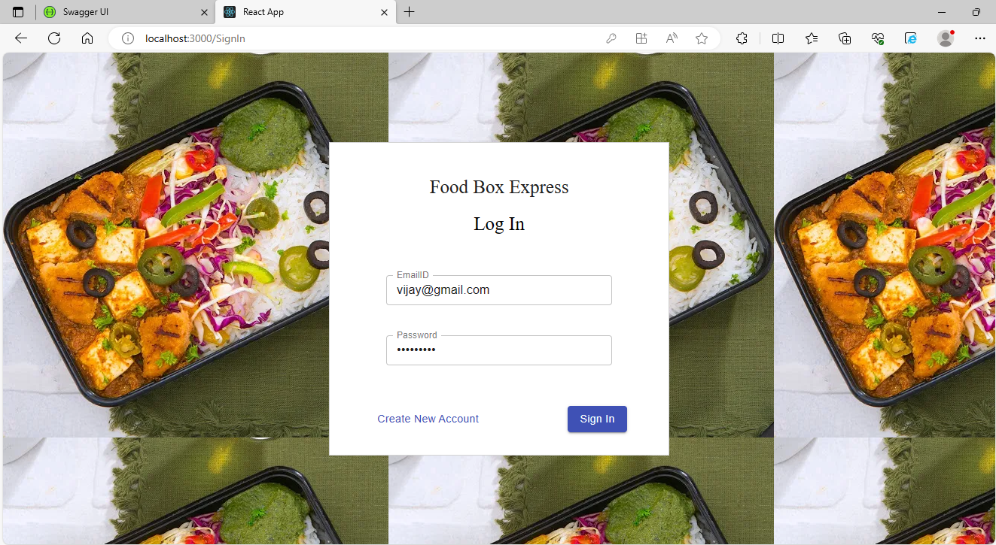
Sign in using Admin:-

Slide 15
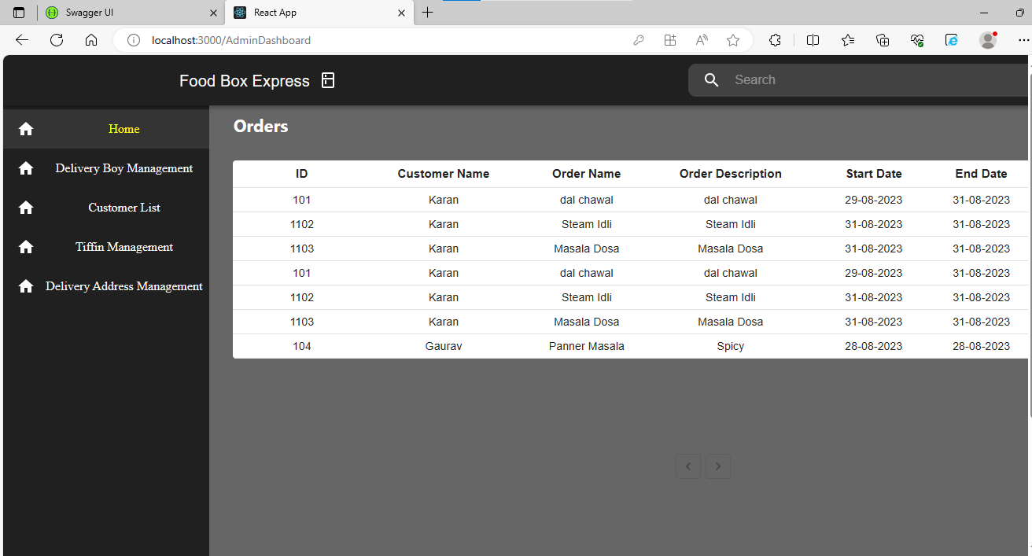
Admin Dashboard:-

Slide 16
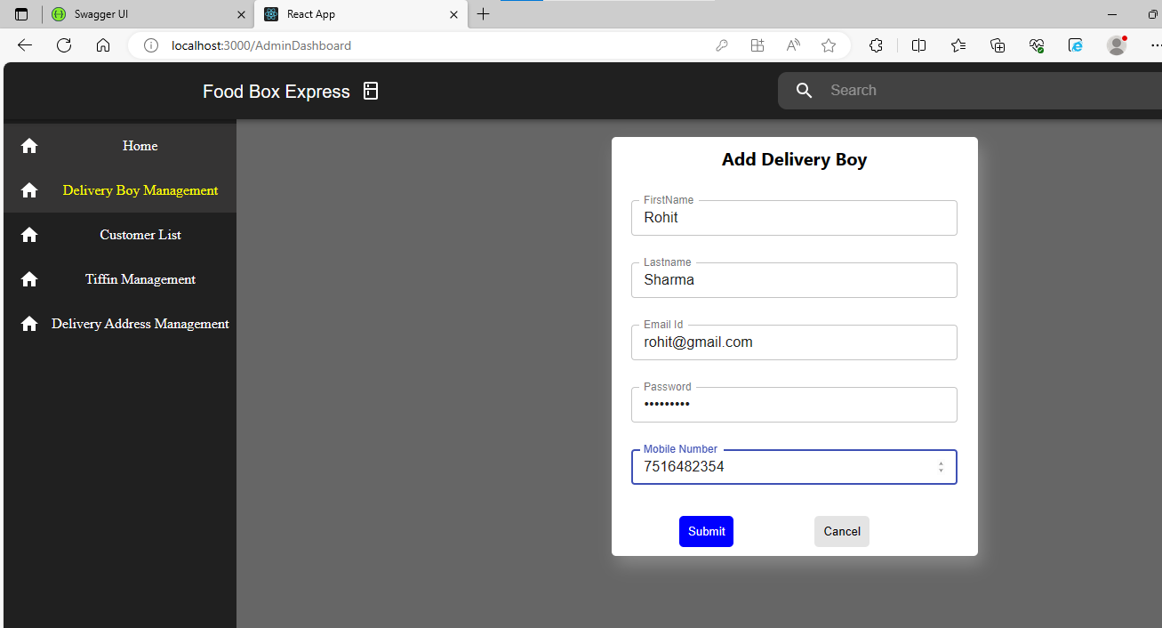
Add new Delivery Boy:-

Slide 17
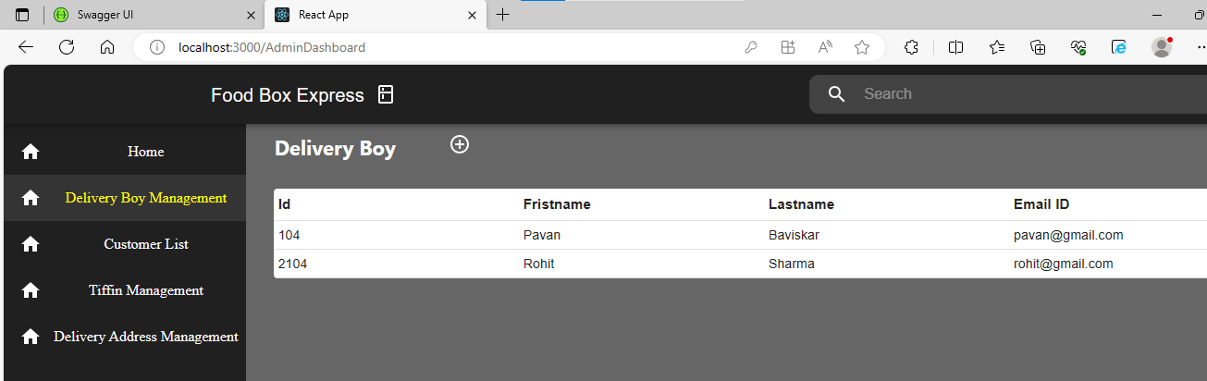
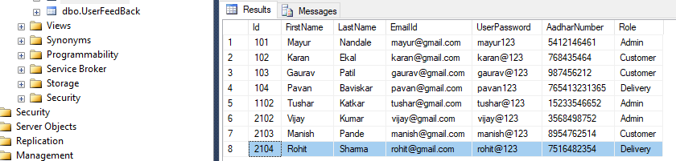
Delivery Boy Added Successfully:-

Slide 18
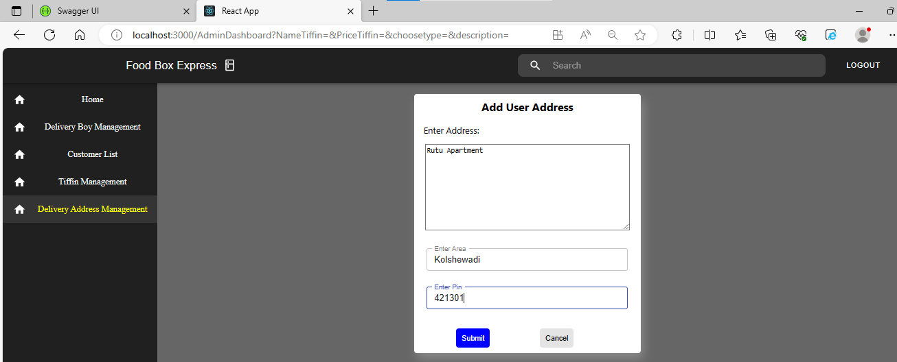
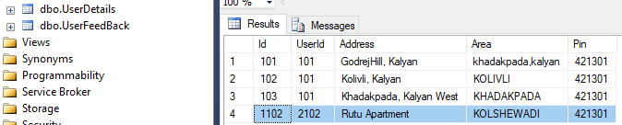
Add Address:-

Slide 19
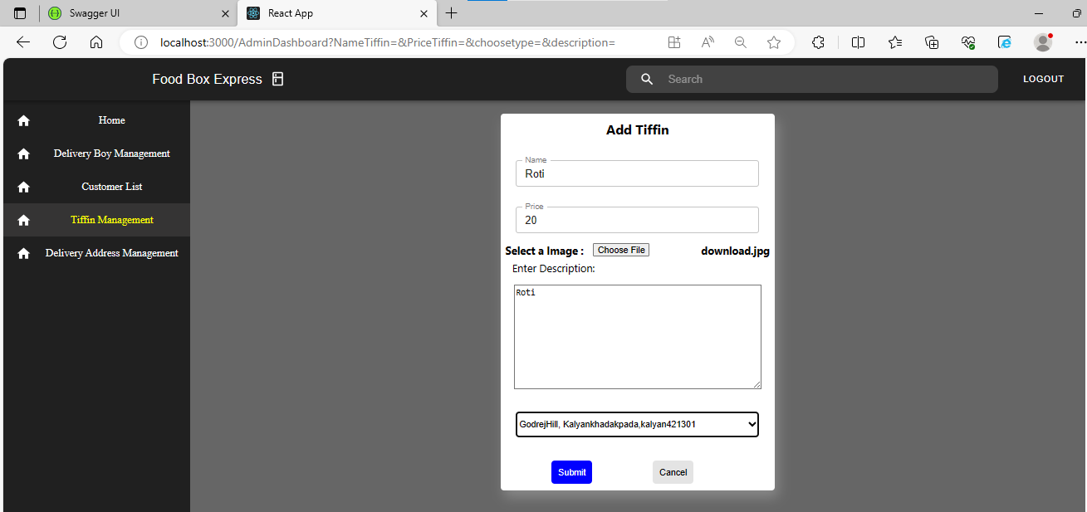
Add New Tiffin:-

Slide 20
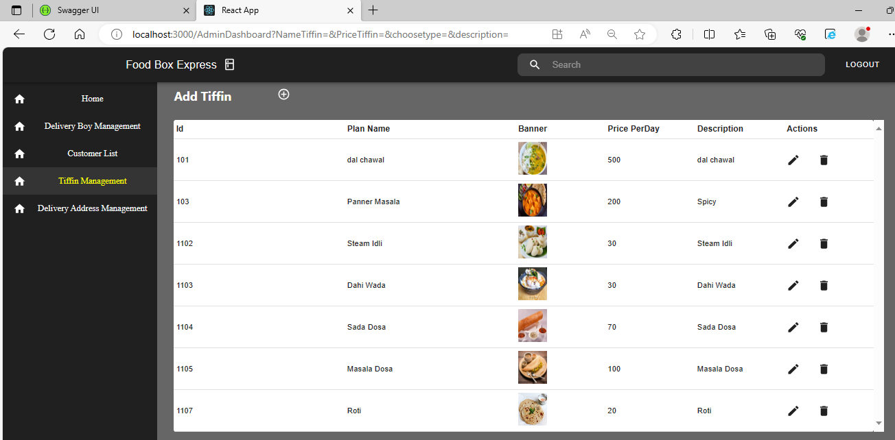
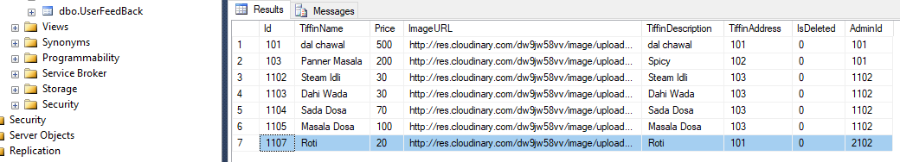
Tiffin Added Successfully:-

Slide 21
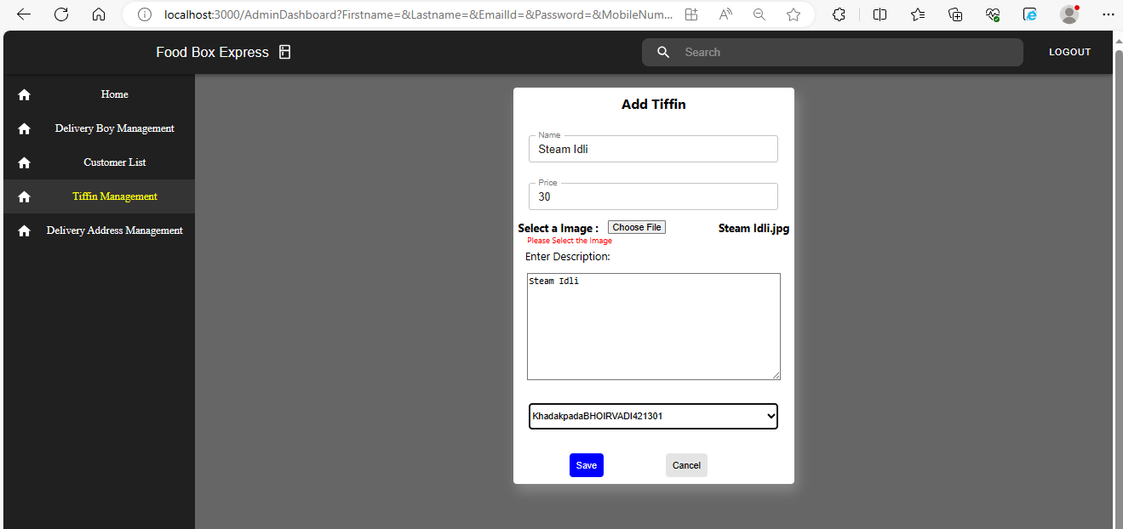
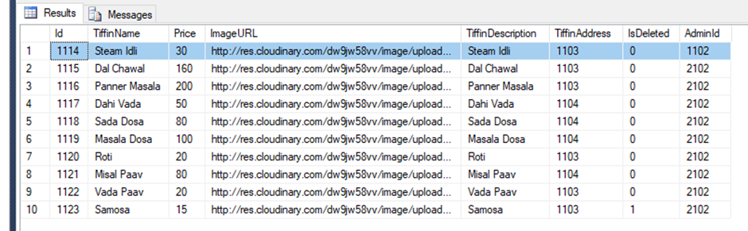
Edit Tiffin Detail (Price):-

Slide 22
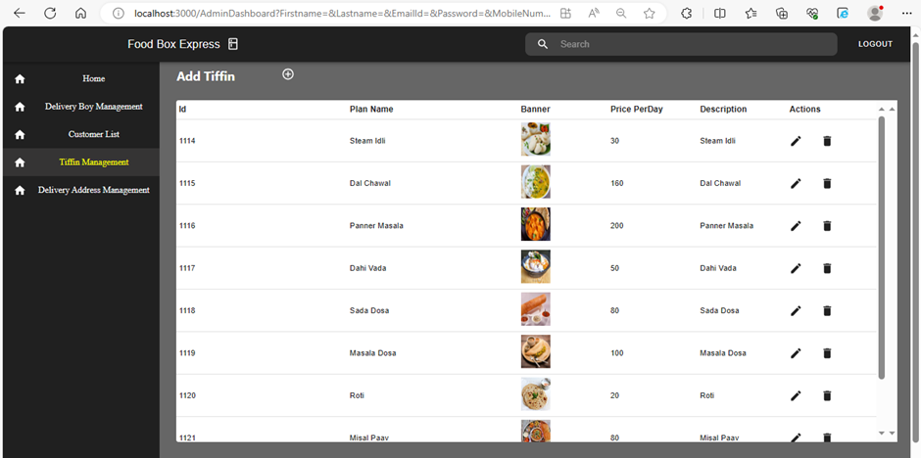
Price Updated Successfully:-

Slide 23
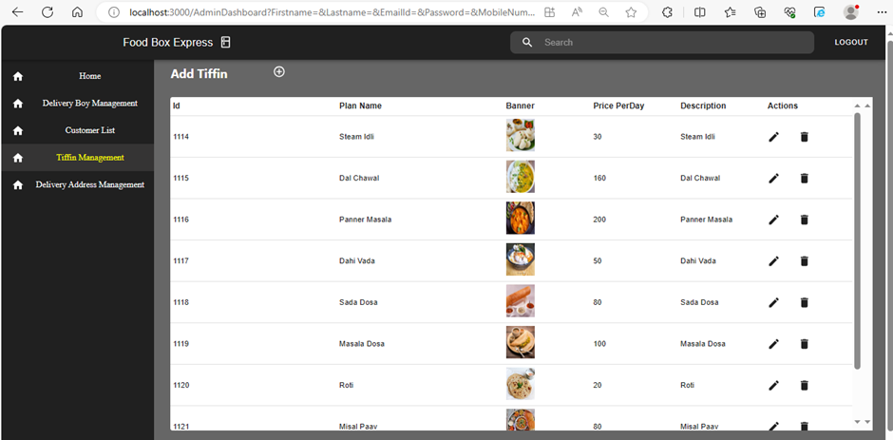
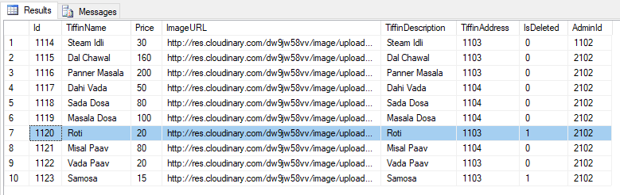
Delete Tiffin (Roti):-

Slide 24
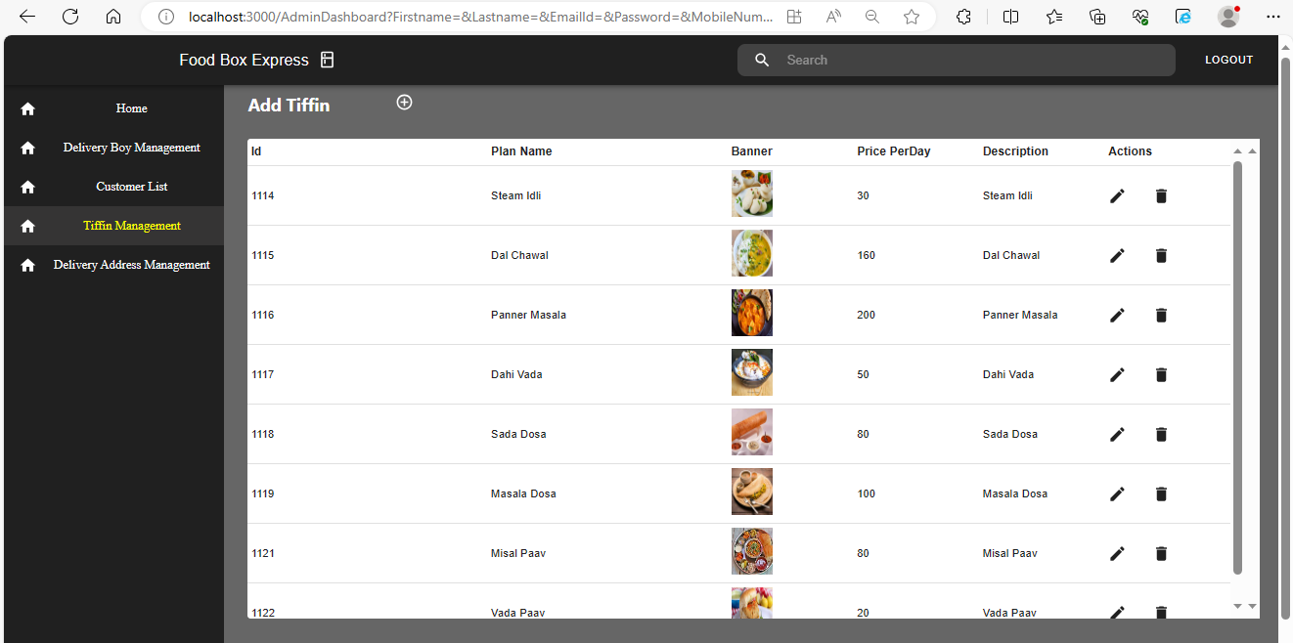
Tiffin Deleted Successfully (Roti):-

Slide 25
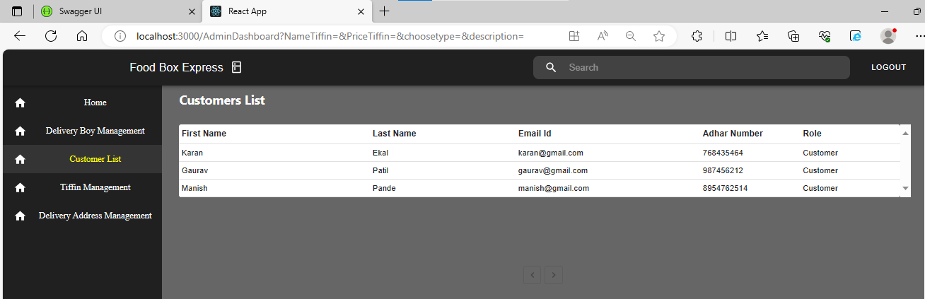
Customer list:-

Slide 26
USER:-
User Can Access The :-
Register/Login Page
Edit Profile
Add Address/Select Area
View/Select Menu
View Order
Payments
View Order Status

Slide 27
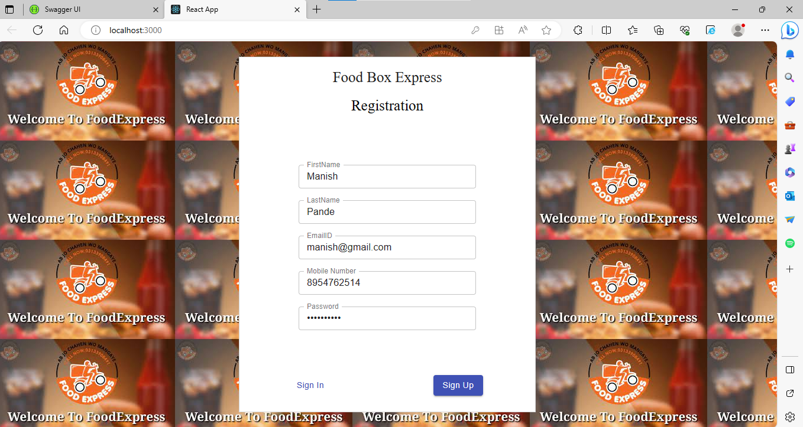
Customer Registration:-

Slide 28
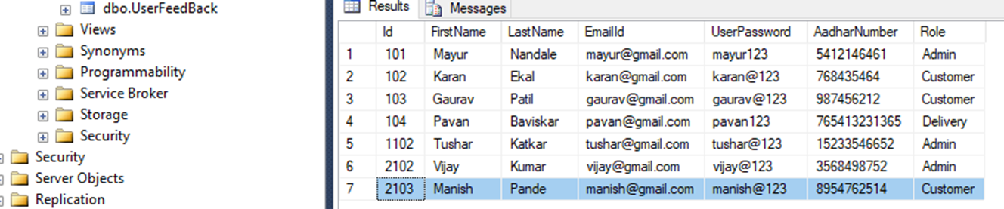
Customer Registered Successfully:-

Slide 29
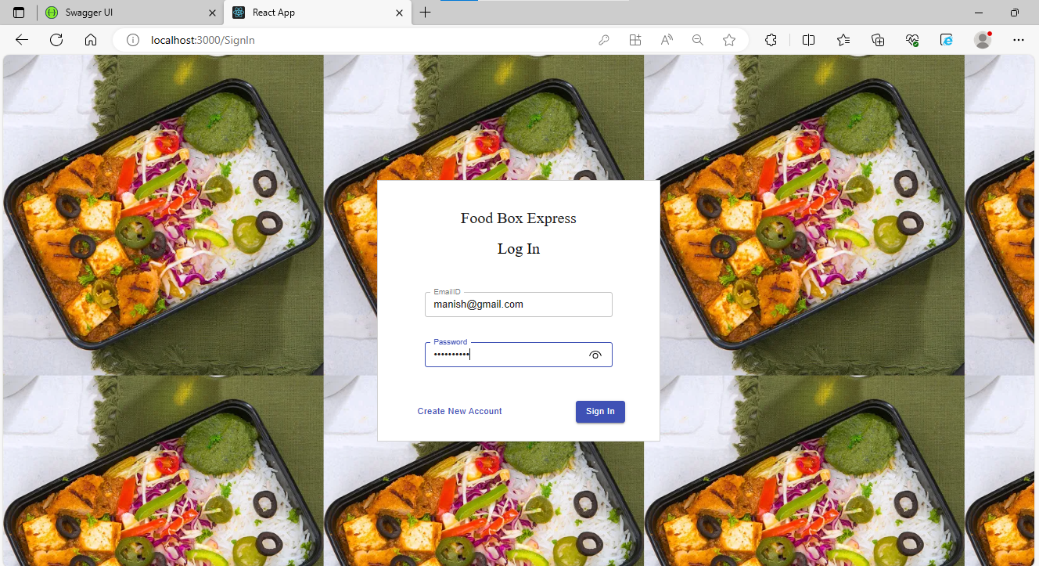
Sign in using Customer:-

Slide 30
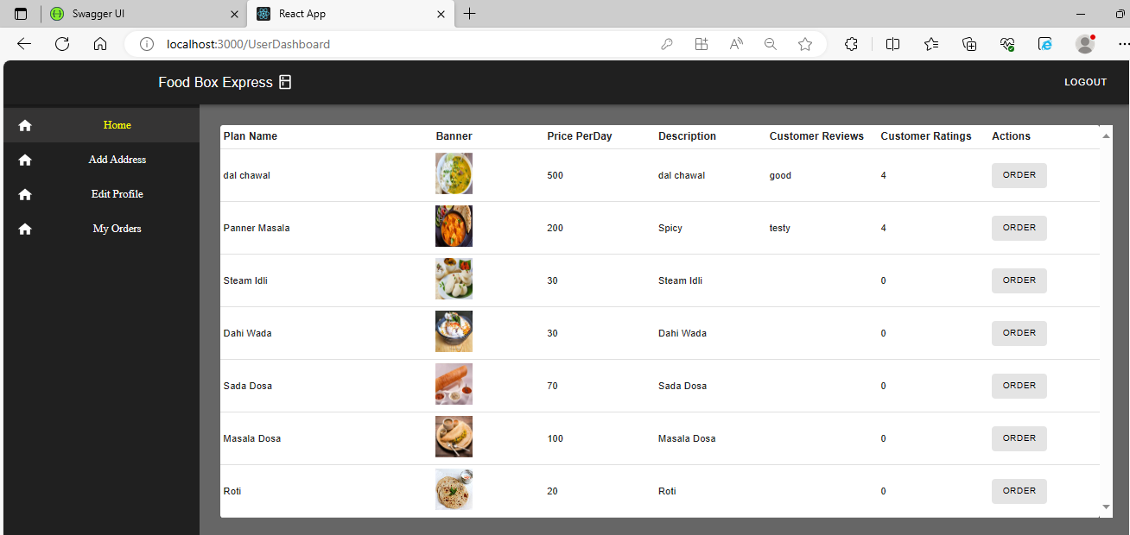
Customer Dashboard:-

Slide 31
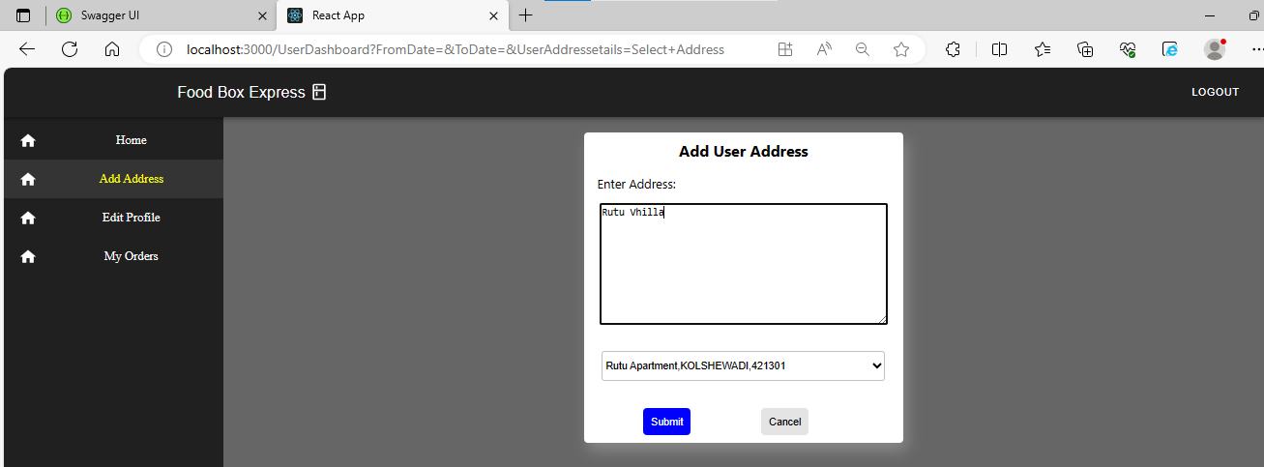
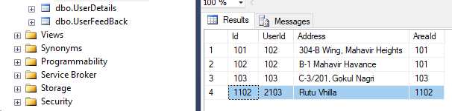
Add User Address:-

Slide 32
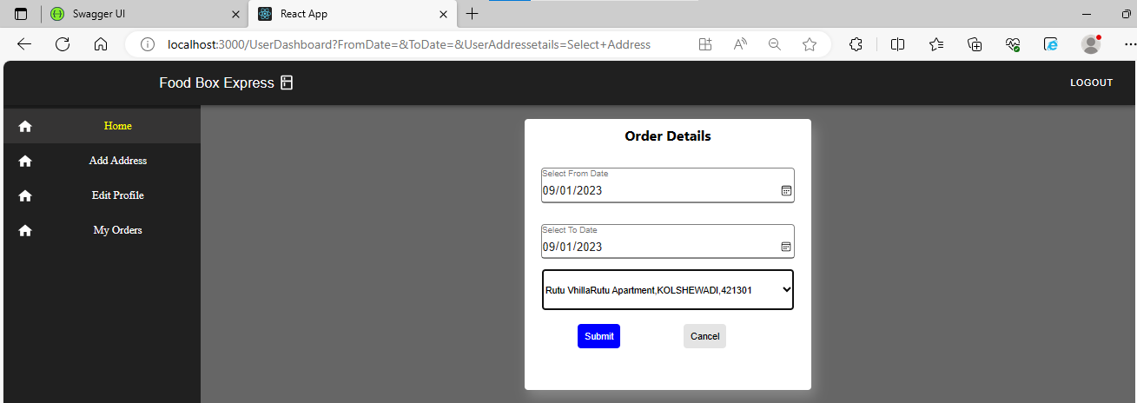
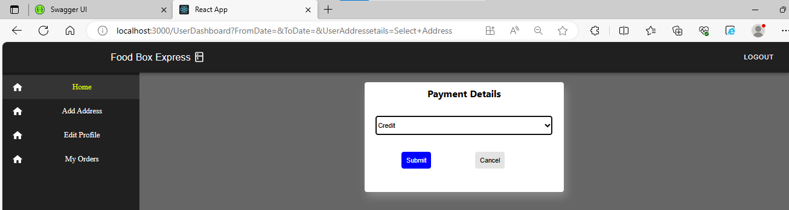
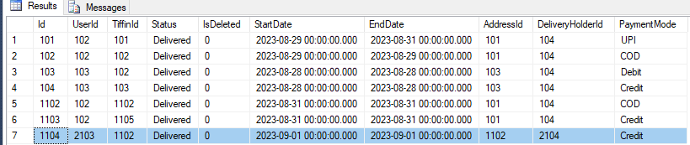
Order the Tiffin
Payment Done:-

Slide 33
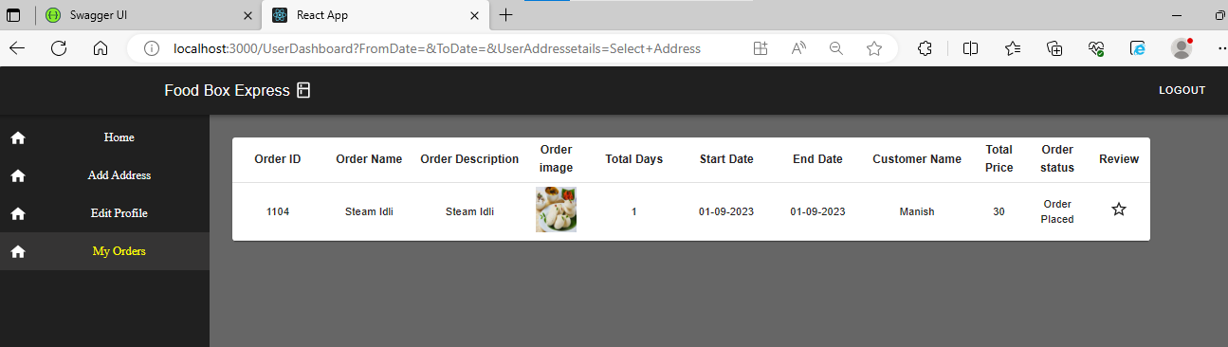
View order details:-

Slide 34
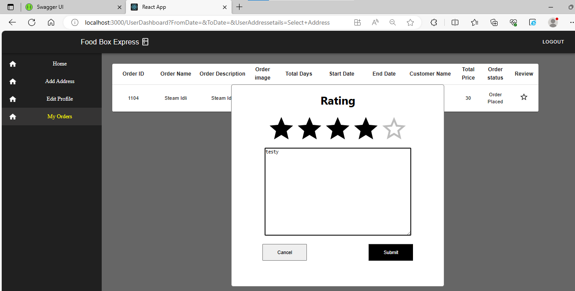
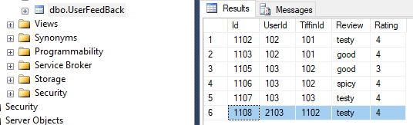
Rate the Food:-

Slide 35
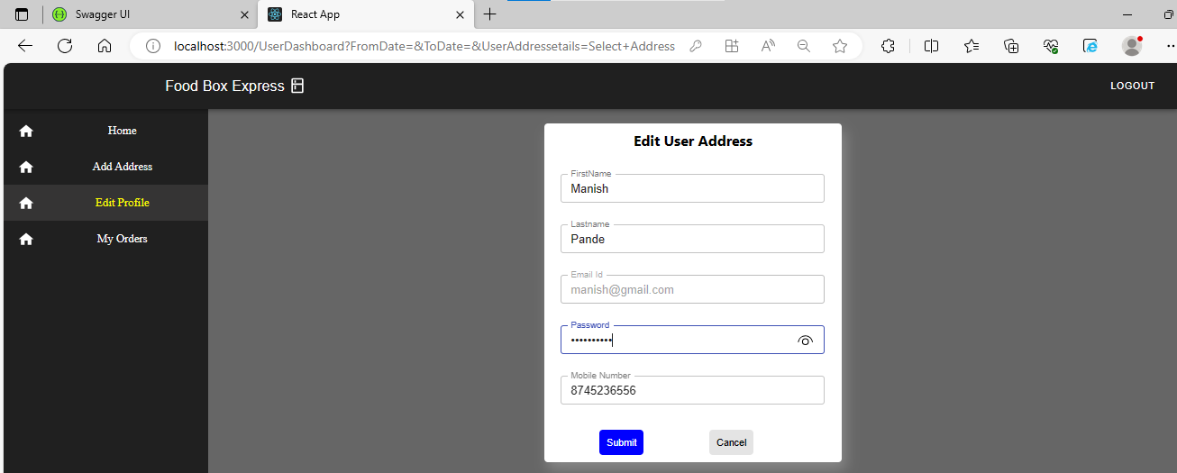
Edit User Details:-

Slide 36
Delivery Boy:-
Delivery boy Can Access The :-
See today’s delivery summary
Update delivery status

Slide 37
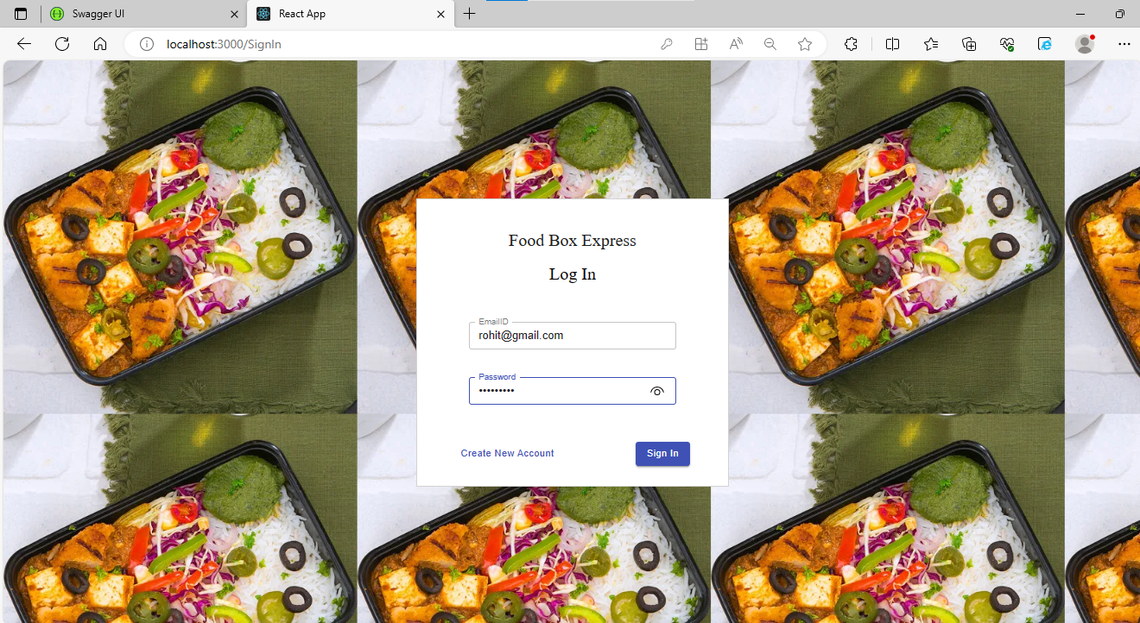
Sign in Using Delivery Boy:-

Slide 38
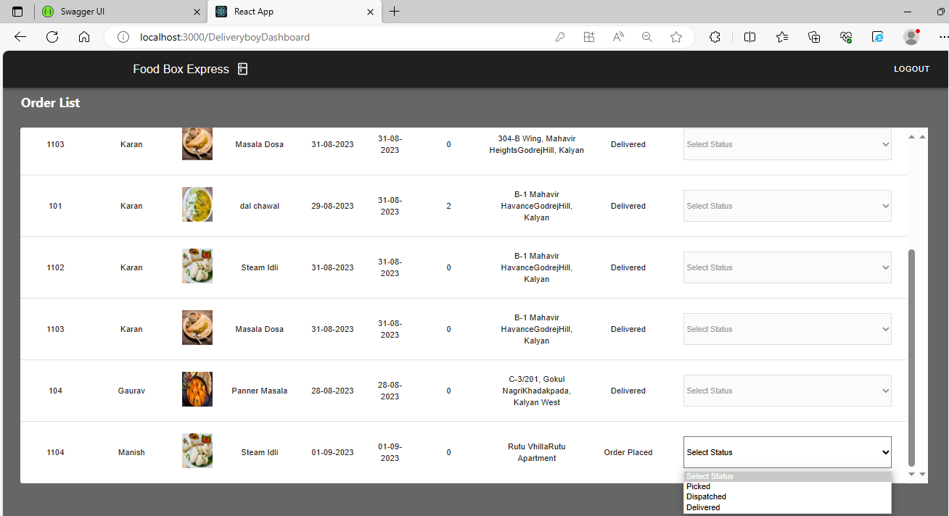
Delivery Boy Dashboard:- (Delivery Boy change the Order Status and view the delivery list)

Slide 39


